Slide 1
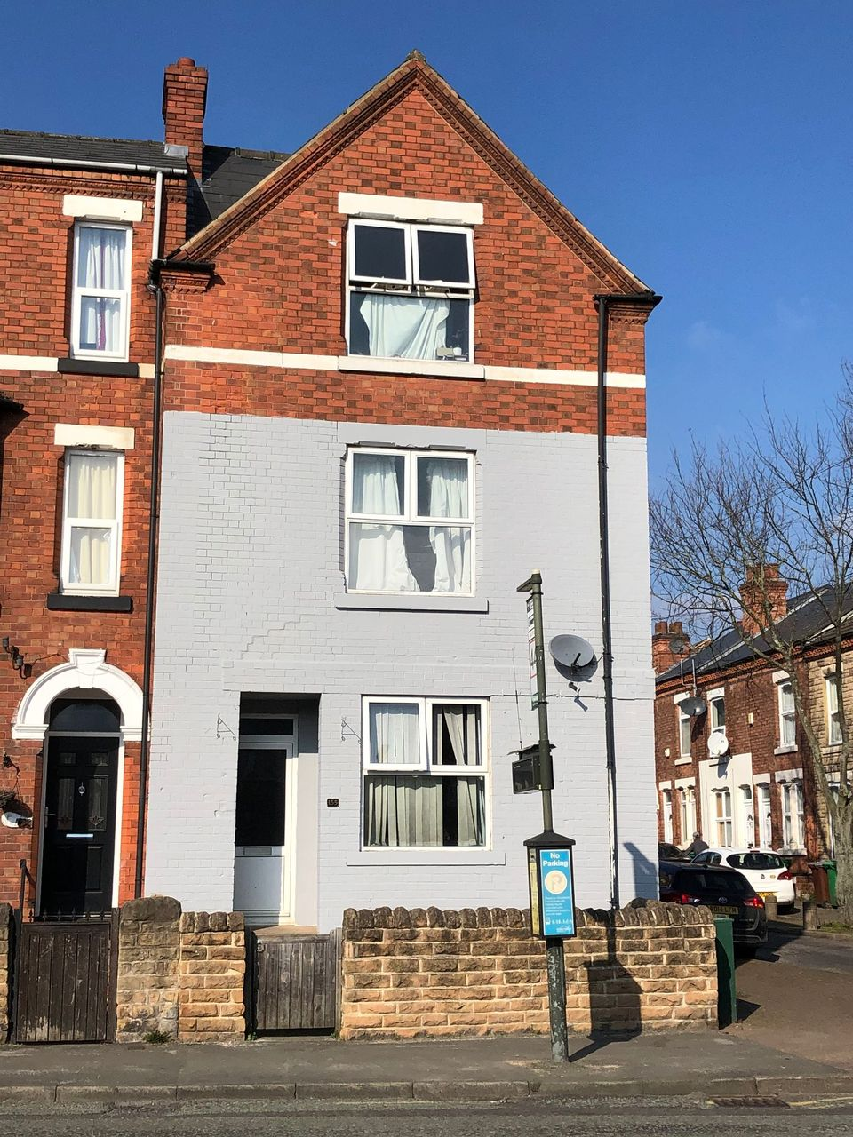
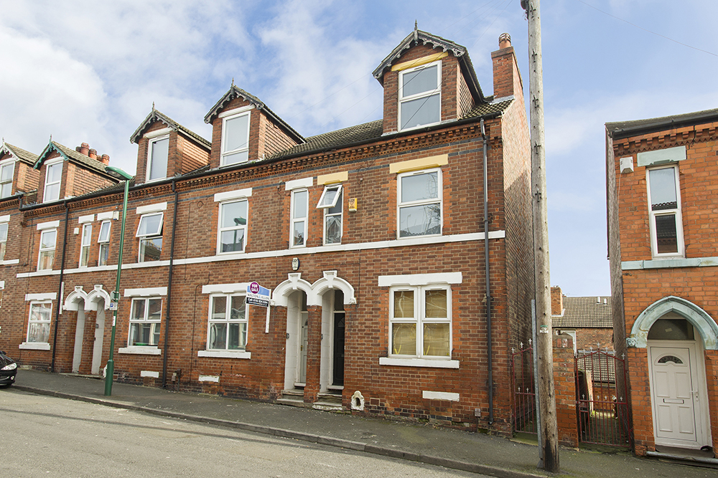
We need to talk abOUT HMOs…
Mike Smith
MS Block Holdings LTD / Notts ReloCATE LTD

Slide 2


Background – Mike SMITH
Introducing Mike Smith, a veteran HMO Landlord & Letting Agent….
Mike has operated HMOs for a nearly a decade since 2013 when he bought a large house in Nottingham and rented rooms to friends.
Started off buying my own HMOs and built a small portfolio of HMOs.
To manage the rooms well, he set up a small letting agency Notts Relocate Ltd which has run successfully for 8 years
From 2018 set up a development business MS Block Holdings Ltd which owns a diverse range of property including HMOs, Blocks of Flats & Industrial.

Slide 3
Introduction – WE NEED To TALK ABOUT HMOS
Firstly we need to ask are HMOs a viable investment in the current macro-economic climate? How are HMOs performing in the inflationary environment?
Secondly what can be done to mitigate some of the recent operating cost increases?
Finally I will do some analysis on some recent HMO sales and ask the bigger question. Should you sell your HMOs now?
If you are doing anything HMO related, this talk will give you some great insights into where the market is going.

Slide 4

INTRODUCTION - Issues
Section 1: Macroeconomic issues within the HMO market.
“ A small leak sinks a great ship”
Benjamin Franklin

Slide 5
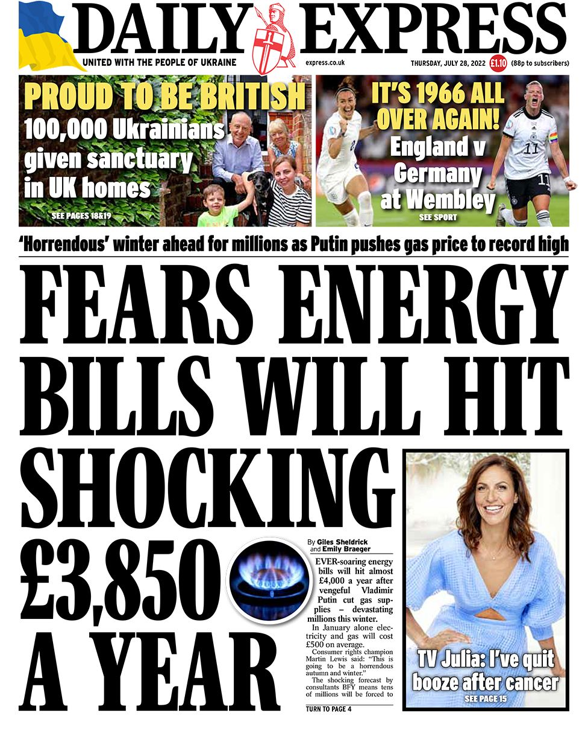
The ISSUE: INPUT COST RISKS
Massive HMO input cost increases in 2022-23.
Utility bills are up substantially. Every £1 of gas on March 31st 2022 will cost £2.47 on October 1st
£500-£600 per month utility costs per HMO will be the norm.
The Ukraine War, the main driver of Energy Prices is in stalemate with no clear end in sight.
Materials, contractors, staffing are all increasing rapidly. E.g. In 2022 April RICS said building material cost increases were at a 40 year high.
Increases in HMO License fees and Council Tax. Nottingham City Council see the PRS as a cash machine.
Overall input cost are increasing substantially with more rises predicted in April 2023.

Slide 6
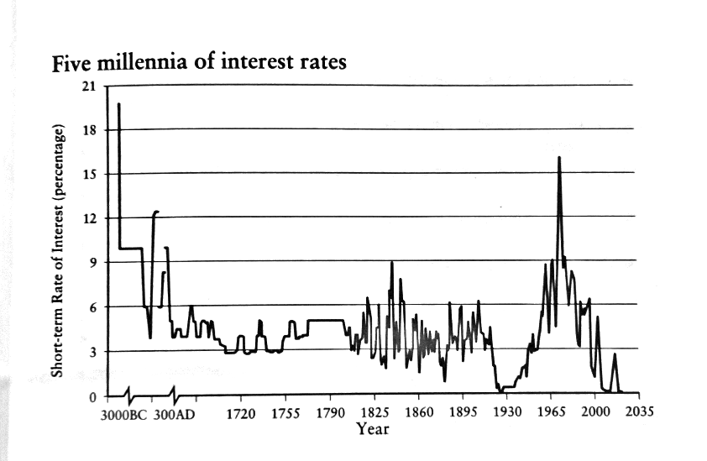
The ISSUE: FINANCE COST RISKS
Inflation is currently 10.4% and many Banks such as Citi are predicting 18%-20% inflation by April 2023
To control inflation the Bank Of England are legally mandated to increase the Base Rate, thus HMO lending costs will increase.
On Base Rates of 1.75%, HMO Mortgage lending is currently available at around 5.5%
The City are predicting Base Rates of 4% by May 2023 which could mean HMO Mortgage lending is around 7.75% by May 2023?
The historic average is around 4%. The last 12 years of cheap money are the exception. (Graph: Edward Chancellor, Price of Time)
Overall: Substantial finance cost increases for HMO Investors. The era of cheap money is over.

Slide 7
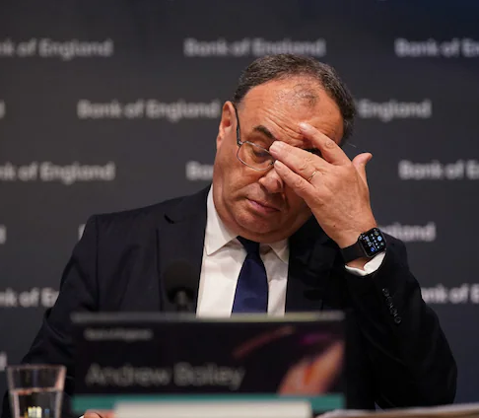
2022-23 Recession
A recession is highly likely towards the end of the year due to the Inflationary pressures.
Many datasets show a recession is almost certain.
Many HMO Tenants are in low paid insecure work, or on 0 Hour contracts. Jobs that are likely to be the first to go in a recession.
Inflation disproportionally effects the less well off. If you had a choice between eating a paying the rent, what would you do?
Arrears / bad debts are likely to increase.
With all these increased risks and costs, it is a bleak scenario for HMO investors. Many HMOs will become liabilities, not assets and lose money if nothing is done.

Slide 8

Introduction - Solutions
Section 2: SOLUTIONS
(NO MAGIC BULLETS)
“It’s not what happens, it is how you react”
Epictetus, Stoic Philosopher

Slide 9

INCREASE RENTS NOW
When input costs increase, the end user has to pay the increased costs. Rents have to rise sharply or your HMOs will rapidly become a liability not an asset.
The maximum legal amount of 10% should be a minimum, given the cost increases investor’s face. Less than 10% and costs will not be covered.
A carefully worded letter outlining the input cost increases will be understood by the tenants. This has worked well in my business and 95% of tenants have not questioned it.
When there is a tenant change over, you can try to push it beyond the 10%. Current demand for rooms is excellent and we have pushed rents to levels we thought not possible.
Even a very basic room in Hyson Green that was £375pcm for years is now easily getting £450pcm plus.

Slide 10
Rental increase Data Analysis
A lot of investors feel uncomfortable with rent rises but the data clearly supports a rapid increase:
Wage Rises always directly effect rental increases. National Living Wage is increased by 6.6% in April and unemployment remains low (for now). Tenants can afford to pay more, despite high inflation.
Research by Zoopla found that in the PRS market rents have gone up by 10.6% in Nottingham. Rents of small flats have risen sharply, so some flat demand is being displaced into the HMO market. In a recession this displacement effect could become greater due to tenants ‘trading down’.
In the inflationary environment with high utility costs, all bills included rooms are worth more money to tenants as savings are greater. Thus you can ask for more rent on your HMO rooms.
The Exception: LHA HMOs. LHA rates are climbing too slowly to put up the rent. Many LHA HMOs are unprofitable and as a model is effectively finished by the current inflationary environment.
Conclusion: Rents must go up sharply to cover input cost increases there are many reasons to be confident about increasing rents now.

Slide 11
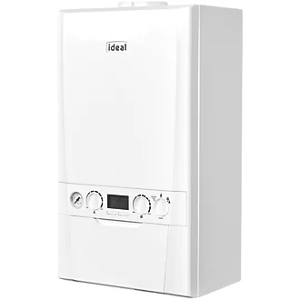
ACTIVE MANAGEMENT OF HEATING
Due to the price of energy the cost benefit analysis is now in favor of active asset management of the heating systems. Some strategies we have put in place include:
Use of Smart Meters to compile usage reports. Usage must be monitored and managed on a regular basis.
Fair Usage Policy within the Tenancy Agreement. A well timed letter advising tenants that they will be all charged if misuse continues does reduce usage every-time.
The Fair Usage Policy means the tenants self police the heating for you.
Letters advising that energy usage has a direct impact on Rent Rises in the future is a good deterrent.

Slide 12

Inspire Home Automation Thermostat
Have experimented with many systems over the years but by far the best is the Inspire Home Automation Landlord thermostat. The best features are:
A) You can lock 24/7 mode where the majority of energy wastage occurs in HMOs. A boost button and timed function keep it legal.
B) The Thermostat measures the temperature of the house and keeps it constant.
C) There is a Master Control so if you have Multiple HMOs you can adjusting heating with logging into one account and one button!
D) The system can be set to email you if tenants attempt to adjust it so you can be proactive and ask them if they need it adjusting.
https://www.inspirehomeautomation.co.uk/landlord_versions.php

Slide 13
Tenant SELECTION DURING INFLATION
The Inflationary Environment effects different HMO tenant types differently. Careful tenant selection is even more important.
LHA Tenants will be unable to pay rental increases as LHA rates have increased far behind inflation. With Universal Credit they are likely to fall into arrears easily due to inflating food prices. LHA tenants are also more likely to misuse the heating.
Employed tenants. Demand is currently excellent with low unemployment. Fix the roof whilst the sun is shining and only select recession proof tenants. E.g. A recession will hit restaurant staff more than care-home staff.
Student HMO demand typically rises in a downturn. Research has found a 1% rise in the adult unemployment rate was associated with a rise in full-time student enrolment of 8.8%. (Betts and McFarland, 1995).
Misuse of heating risks are much higher with students.
Conclusion: Due to the Inflationary Environment, HMOs will be less profitable, even with all the mitigation strategies outlined. There is no magic bullet.

Slide 14

Introduction – PEAK HMO?
Section 3 – Is This Peak HMO? Is it time to sell your HMOs?
“Be fearful when others are greedy. Be greedy when others are fearful."
Warren Buffett

Slide 15

Is this peak HMO? Time to sell your Hmos?
HMOs are a hot market.
Sold Yields of 8-10% of the Gross Rent Income have become the normal selling yield for HMOs in Nottingham for instance.
On a street where a standard terrace goes for £200k, an HMO easily goes for £300k+
Prices have been rising substantially due to the Article 4 Directive restricting new HMOs.
Key Question: We need to ask are these selling yields sustainable when operating costs are rising dramatically?
How will selling yields be hit by rising interest rates?

Slide 16
Example: 155 Colwick Rd, NG2 4AP
Let’s have a look at an example of a recent house I sold. I have done some modelling on the impact of the inflationary environment on it.
155 Colwick Rd, Sneinton, Nottingham, NG2 4AP (6 Bed HMO)
Sale price: £315k (Feb 2022)
Sold Yield: 9.14% (Feb 2022)
Net Yield: 5.12% (Feb 2022)
Since the sale interest rates have risen by +1.25% and gas energy price will be +240% more by October 1st (from Feb 2022)
By October 1st when the energy price cap changes the net yield will be compressed to just 3.72%!
Is a 3.72% net yield a fair return for the risk / work of a HMO?

Slide 17

Example: 155 Colwick RD, NG2 4AP
Future interest Rate increases will mean further yield compression.
The City is predicting the Base Rate will be 4% by May 2023. Remember, the Bank of England is legally mandated to control inflation via rate rises.
HMO rates would shoot up to an estimated 7.75% in this scenario.
4% Base Rates would mean an estimated +£225pcm of additional interest costs on this house (@ 75% LTV)
In a 4% Base Rate scenario the net yield on this house would be only 2.9% net!
Money left in the bank would return more money with no risk!
Once again are these selling yields sustainable?

Slide 18

PEAK HMO FINAL Thoughts
The HMO market has been so buoyant due to a limited supply of HMOs coming to market
When landlords do their tax returns and realize they are making no money on their HMOs, what do you think will happen to supply of HMO properties for sale?
What will happen to demand for HMOs when the net yields are compressed less than a savings account?
What do we think will happen to values?
The only upside of inflation is that in the longer term it does devalue any debt provided rents can be increased

Slide 19
Conclusions
HMOs face serious input cost pressures from all angles. Energy costs and interest rate rises are all serious risks.
Some limited mitigation strategies include putting rents up, active management of heating systems and selection of tenants. There is no magic bullet.
By confident about putting up rents, the market can support it (for now) and it is essential to maintain any profitability. Fix the roof whilst the sun is shining!
Professional and student HMOs do have a in built level of robustness but LHA HMOs will be severely hit.
HMO prices were high before the inflationary crisis.
Yields have been compressed to the point where they make little/no sense.
The sales market is underpinned by low supply. There could be a sell off when landlords realize how little money they are making and more supply comes to the market.

Slide 20
Contact Details
If anybody needs any help with any troublesome HMOs we can help.
We work with both Landlords and other Letting Agents.
We can offer a Guaranteed Rent Solution to assist with any problem HMOs.
Mike Smith: 07895002444 / relocatenotts@outlook.com

Slide 21
Questions
Any questions?

