Slide 1
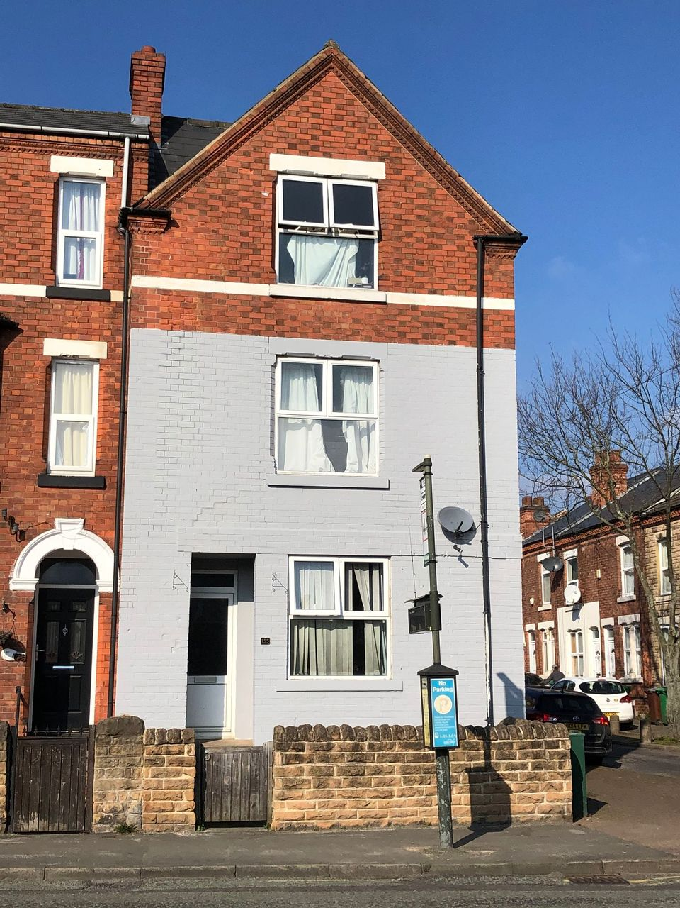
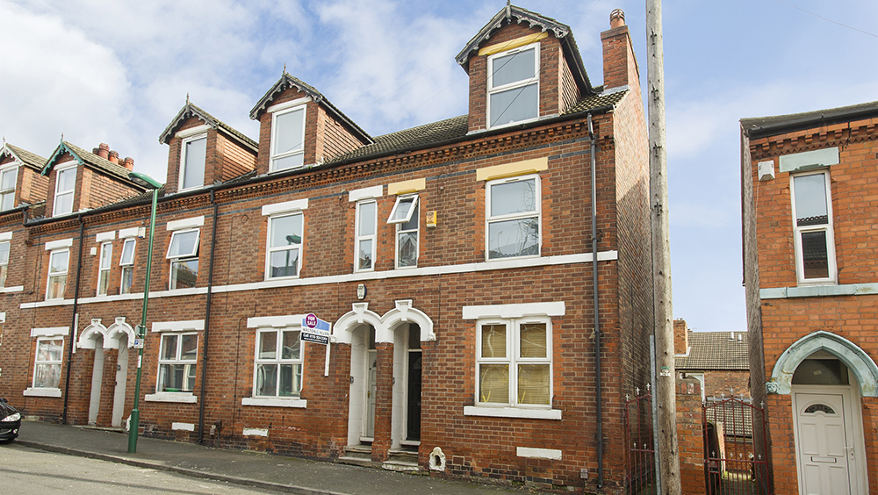
Systemise YOUR HMO BUSINESS TO save time and Money
Mike Smith
Notts Relocate Ltd & MS Block Holdings LTD

Slide 2
Executive Summary – SYSTEMISE YOUR HMO BUSINESS
This presentation will help you systemise your HMO business. It will help you save money and time on your Houses of Multiple Occupation (HMO) by recommending systems, staff and software to improve profitability and quality.
There are also some personal productivity hacks included that will save you a lot of time.
HMO’s can be a very lucrative strategy with high gross yields up to 18%. The issue is that these headline figures are misleading and do not take into account the large operating costs which is not controlled can ruin the net yield.
Your time is your most valuable resource. Many HMO landlords do not factor in the value of their time and so end up owning a job not a business. Time is money and this presentation will recommend many tips to save hours of time.
My analysis is by setting up your own systems and doing in house management, you can get management costs down to about 6% of the gross rent for the same effort as you would need with an agent. This is a potential 50% saving off estate agent costs which are around 12% for HMOs (usually 10% + VAT)
All items recommended in this presentation are low cost, easily available and have a ROI of 100%+

Slide 3


Background
I have operated HMOs since 2013 when I bought a large house in Nottingham and rented rooms out to friends with my only intention was to DJ fulltime. I soon discovered property was a lot more lucrative and bought more HMO’s.
Then I set up a very lucrative HMO letting agency Notts Relocate Ltd and more recently my own development business MS Block Holdings Ltd.
As the companies expanded I went from living the business dream to being overworked and giving myself the biggest most stressful job ever. Something had to change so I became obsessed about implementing systems.
Thanks to the systemisation work, I now do 10 hours work a week on the day to day business and have recently moved to another city.
All this was possible due to the systems and staff, so today I am going to show you my top 10 HMO systems…

Slide 4
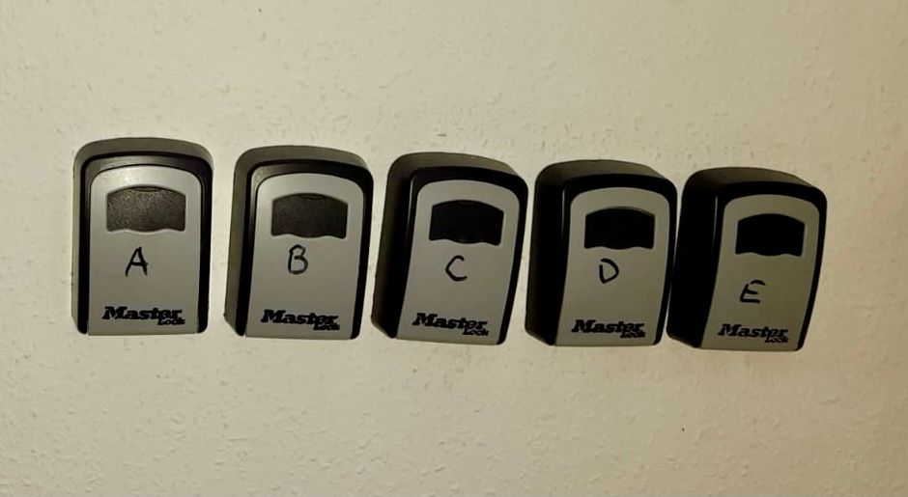

1 – Decentralized KEYS USING KEYSAFES
The problem: Wasting time driving to get keys, being present to let tradesmen in, tenants getting locked out and awkward viewings where you lose a key and cannot get into a room.
All keys are held on site in key safes and not centrally. The system revolutionised the business and means only codes are needed to get in.
The front door has a staff keysafe and each room having an internal keysafes for tradesmen and viewer access.
This means you never need to be there to let tradesmen in and viewers can get in and tenants cannot get locked out.
Tenant keysafe: In a similar way to Serviced Accommodation, the outgoing tenant leaves their keys in the tenant keysafe for the incoming tenant to collect. This means you never need to be present for a move in / move out. This works with a strong system for the move in / move out.
Set up costs: Very cheap costs £250 per house max. As opposed to rival systems like Masterlock it is substantially cheaper and easier to cut keys. It can be implemented today.
Savings: You will save between 1-5 hours per week per house with this system. It revolutionised our business and within a few months paid for itself in time and fuel costs.

Slide 5

2 - Inspire Home Automation Thermostat
The problem: HMOs guzzle energy, in some extreme cases up to £350pcm can be burnt on gas and elec. Control of costs is essential for profitability.
Have experimented with many systems over the years but by far the best is the Inspire Home Automation Landlord thermostat. The best features are:
A) You can lock 24/7 mode where the majority of energy wastage occurs in HMOs.
B) The Thermostat measures the temperature of the house and keeps it constant.
C) There is a master control so if you have Multiple HMOs you can adjusting heating with logging into one account and one button!
D) The system can be set to email you if tenants attempt to adjust it so you can be proactive and ask them if they need it adjusting.
E) Very user friendly, a Virtual Assistant can operate it easily.
Costs: Ignite (Heating Only) Thermostat is £194.99 plus around £50 fitting.
Savings: You will be making profits within 4-6 months maximum.
https://www.inspirehomeautomation.co.uk/landlord_versions.php

Slide 6
3 – Virtual Assistant / remote worker
The problem: HMOs generate a lot of paperwork and hiring a UK based admin assistant can be expensive.
To get excellent admin I would strongly recommend using a Virtual Assistant (VA) based in a low cost country where pay is £2.50 per hour. I have been using Philippino VA since 2017.
Tasks a VA can successfully do include: Using Spare Room, online marketing, booking viewings, ordering washing machines, credit control, the cleaner’s rota, tenant comms, client payment sheets, basic bookkeeping, the list of time saving tasks are endless.
To get the best results you need to have very clearly defined processes that are well documented. Remember staff are only as good as your processes and without a clear workflows it will not be a successes.
Using a company is the best way to recruit a VA. I use Freedom Geek. https://thefreedomgeek.com/home it costs about £300 to recruit a VA.
Costs: Currently pay £2.50 per hour plus a up to £100 a month bonus. So total costs per annum is less than £5,100 per annum for a 30 hour week. Plus there is no tax or national insurance payable.
Compared to hiring a UK based admin or book-keeper there is a large saving.

Slide 7
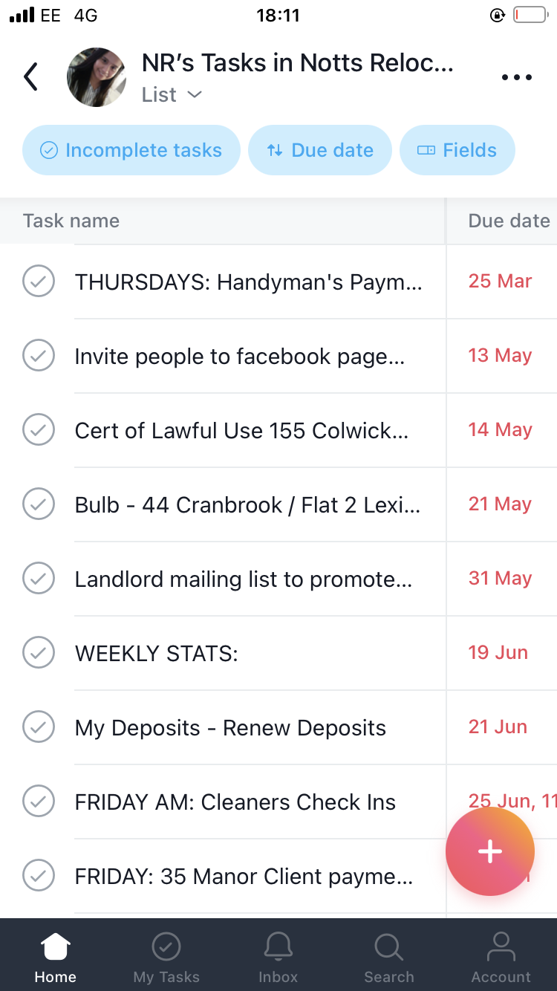


4 – ASANA CHECKLISTS & Screencast O Matic
It is essential when using Virtual Assistants or any staff to give clear workflows and structure. It is a key principle of systemising a business.
The humble checklists is the most powerful tools in systemisation. Airline Pilots and Surgeons use them as it makes it very hard to make a mistake.
Asana is a task management software which allows you to assign tasks to staff members such as a Virtual Assistant, Property Manager or Handyman and means tasks are clearly assigned to the staff member’s to do list.
For regular tasks, template tasks can be set up which contains a sub tasks (i.e. a checklist) this is a very powerful system and means that items cannot be missed. E.g. setting up a tenancy must follow a very strict procedure with items not missed.
To take it further, video tutorials on how to complete the subtasks can be recorded using Screencast O Matic, a screen recording software. Meaning there is little/no training time required to train a Virtual Assistant on how to complete the task.
To save even more time the In-house handyman has Asana on his phone and he uses Asana as his job list. Tenant requests can be added to Asana and assigned direct to him with comments and photos. Note this is only viable if you have a in house handyman.
Overall Asana leads to efficient high quality work and a lot of time saving. Most maintenance tasks I do not even get involved in.
Cost: Asana: Free Screencast O Matic: $1.65 USD per month

Slide 8
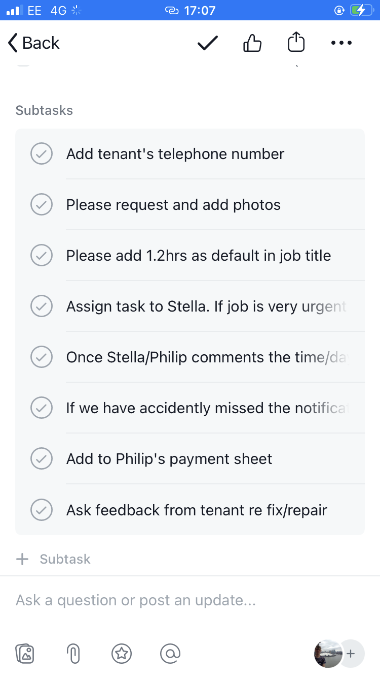
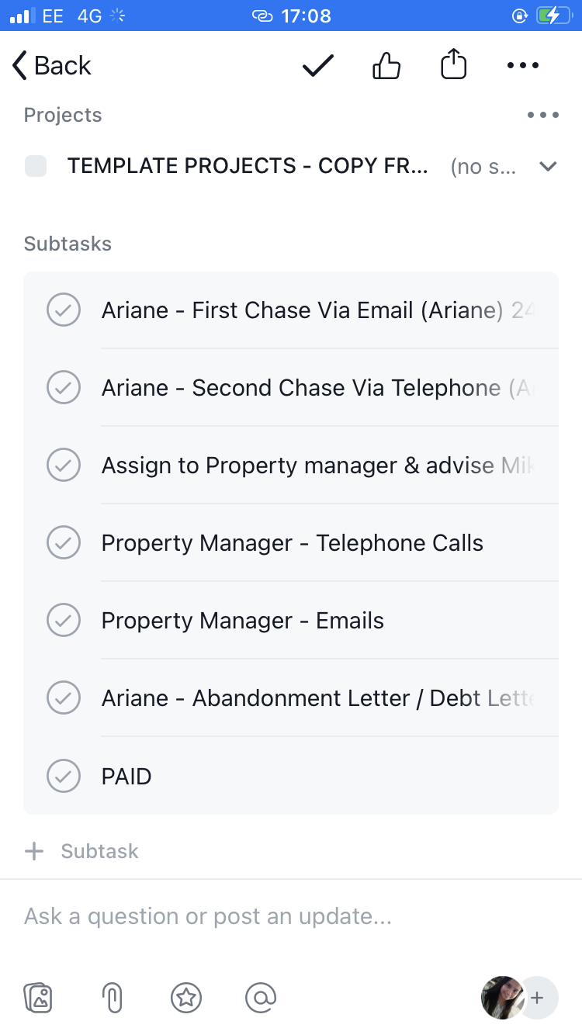
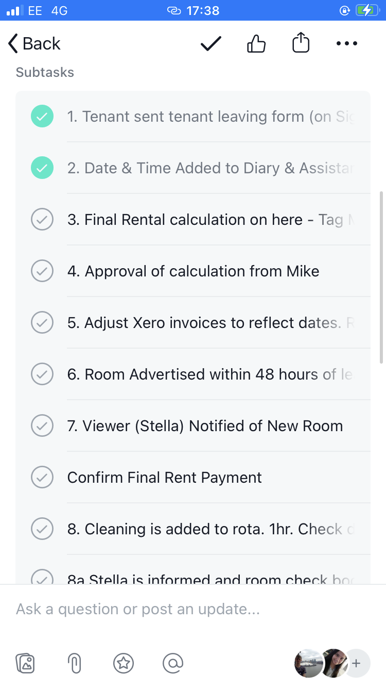
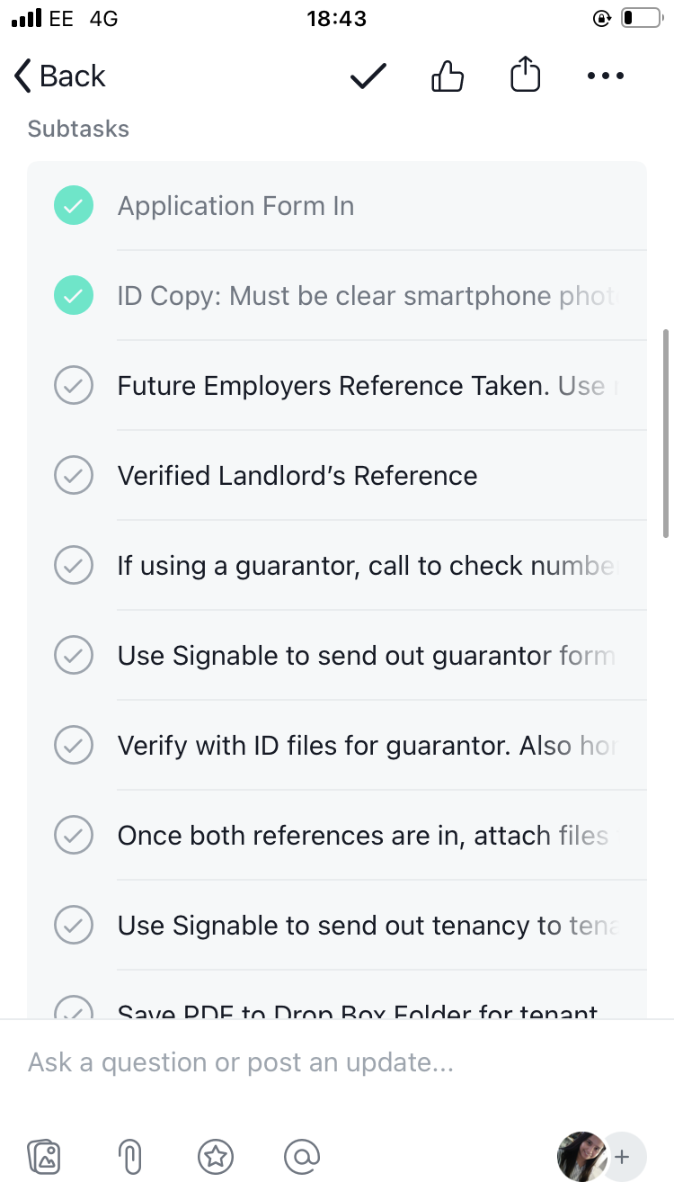
4A – Screenshots of ASANA CHECKLISTS / WORKFLOWS
Maintenance Task Checklist
Debtor Task Checklist
Tenant Leaving Checklist
Tenant Set Up Checklist

Slide 9
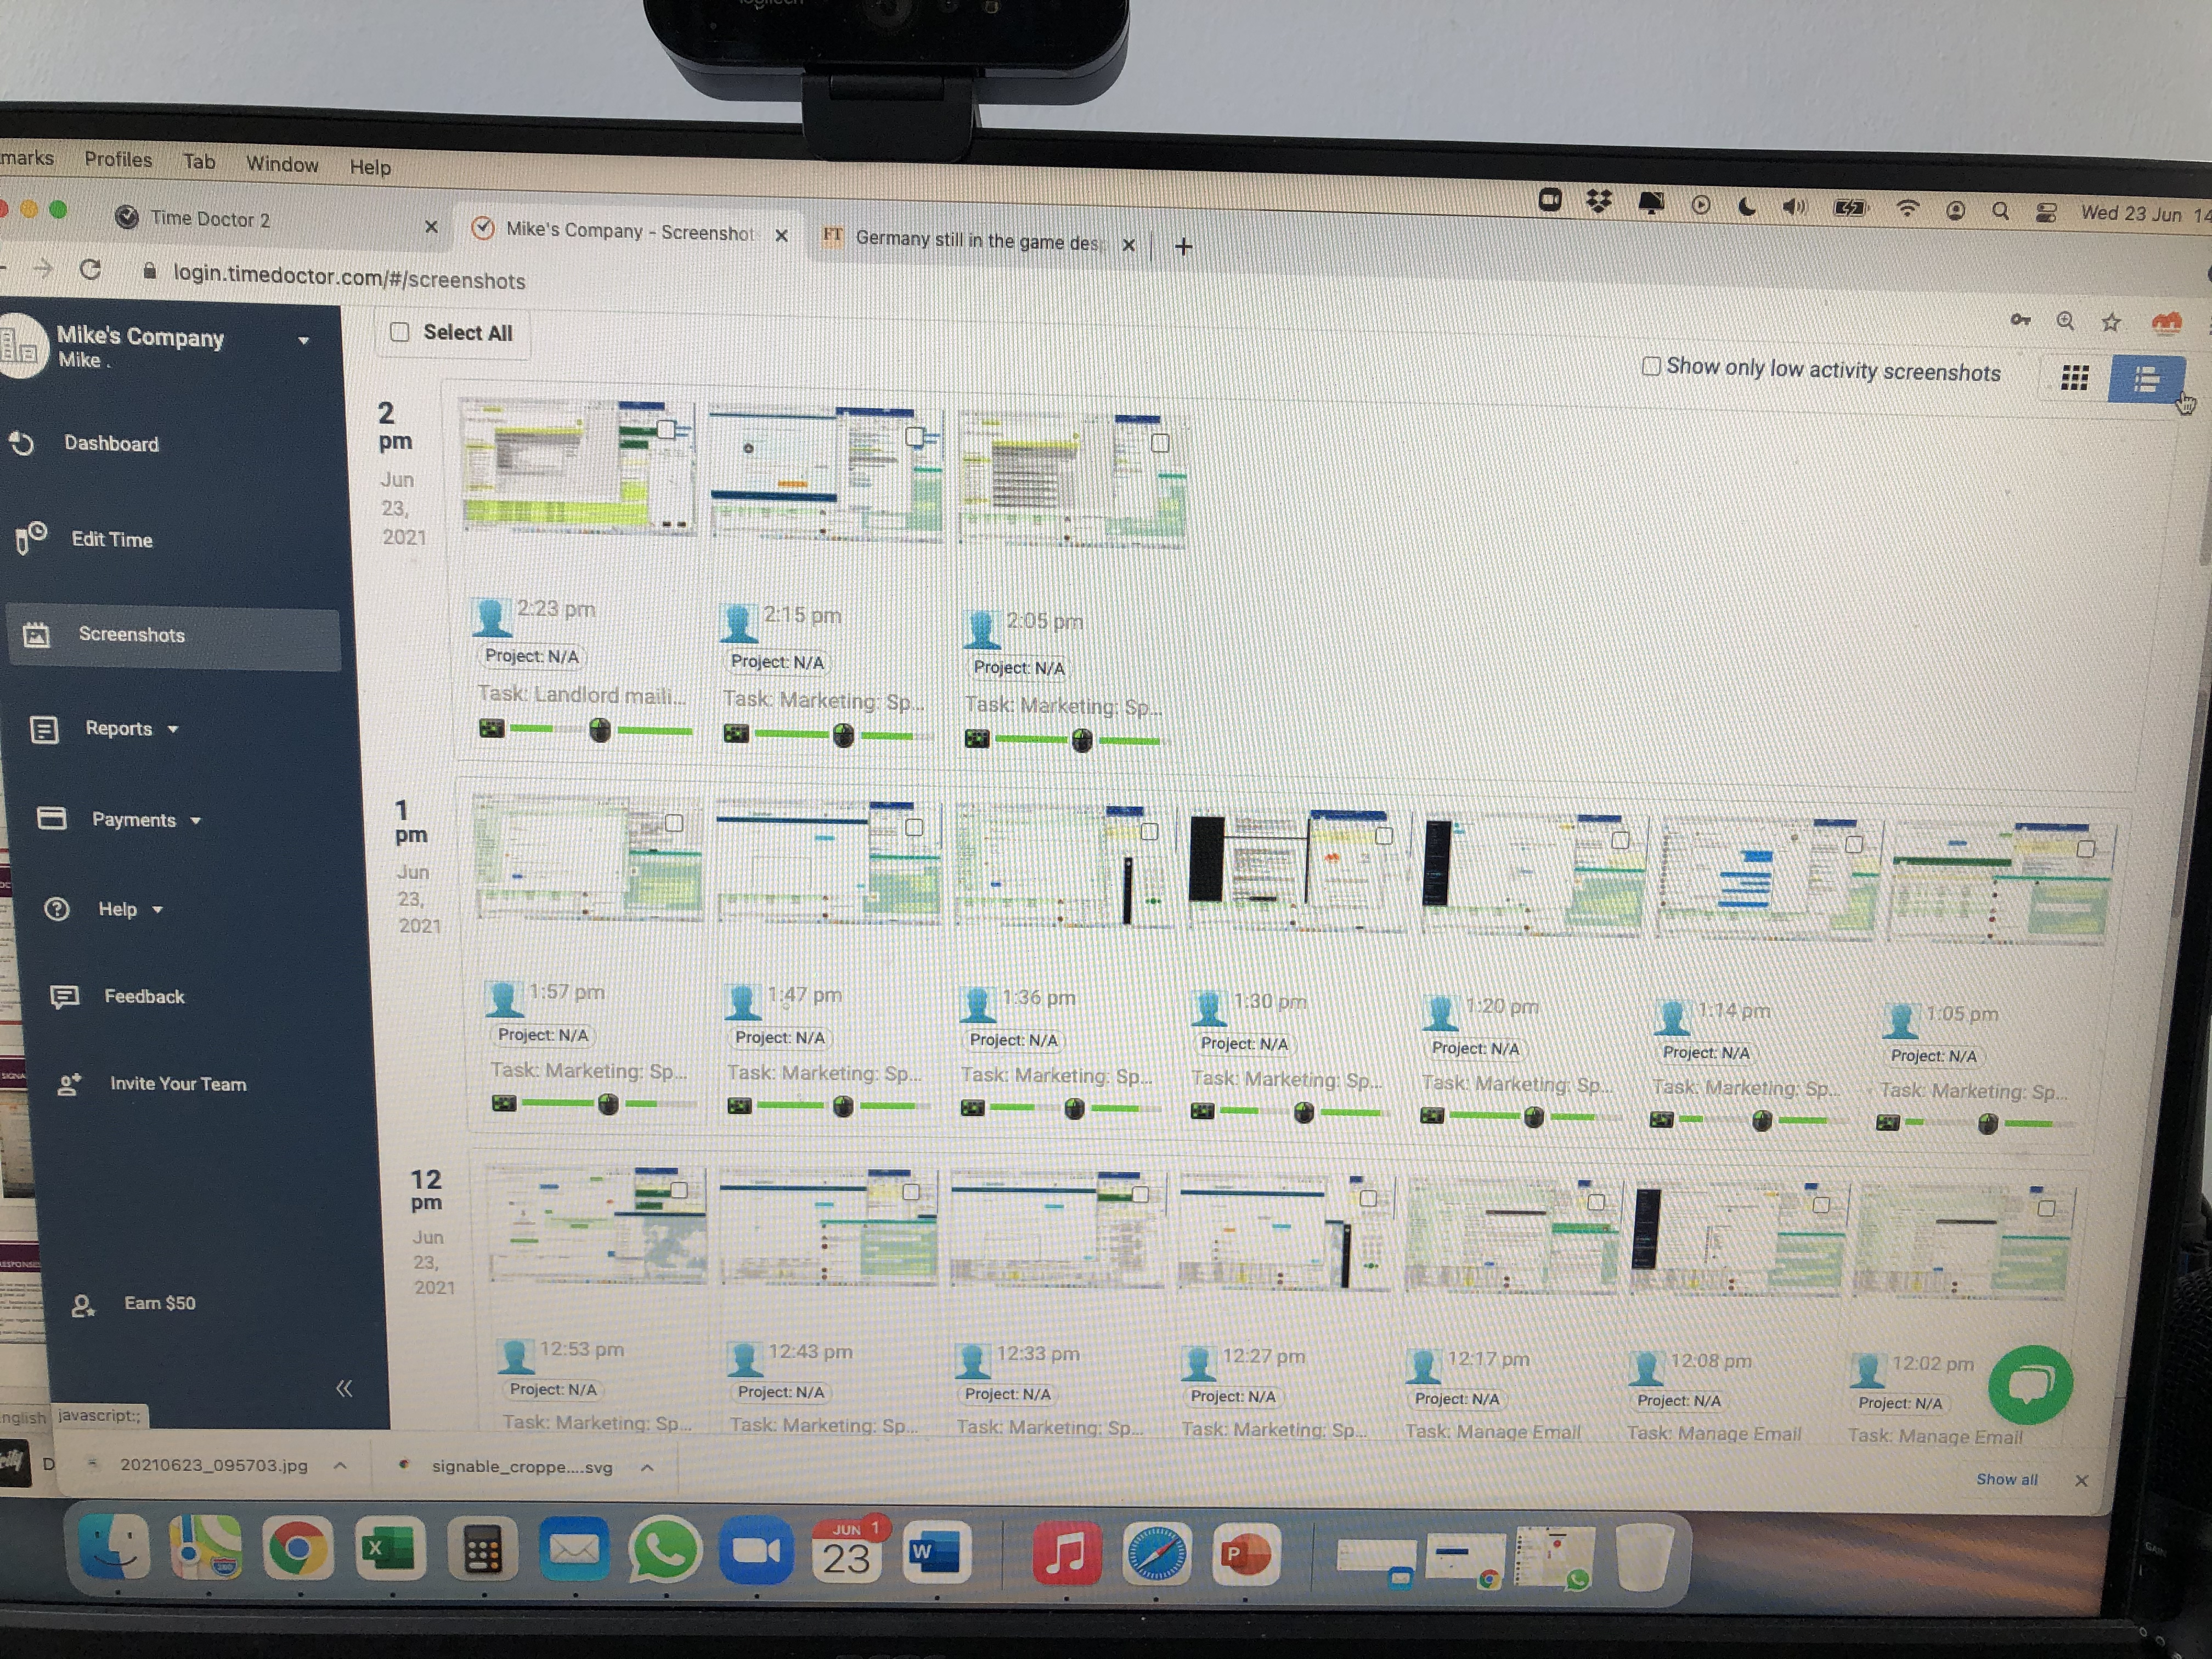

5 – TimeDoctor
The problem: When hiring virtual assistants in another country you need accountability to ensure that your work is being completed. Often remote worker have a couple of jobs.
Timedoctor provides a very low cost solution to track time. When the employee logs on they click into Timedoctor and when they log off they click out.
As well as a timesheet, Timedoctor takes random screenshots throughout the day which can be viewed.
It also can be linked to Asana so you can get reports on which task the VA is working on.
Although I have this system, I have a VA I trust, so rarely log on but it helpful to ensure accountability is always there.
It also can be used to hold yourself accountable!
Cost: Just $7 USD per month

Slide 10
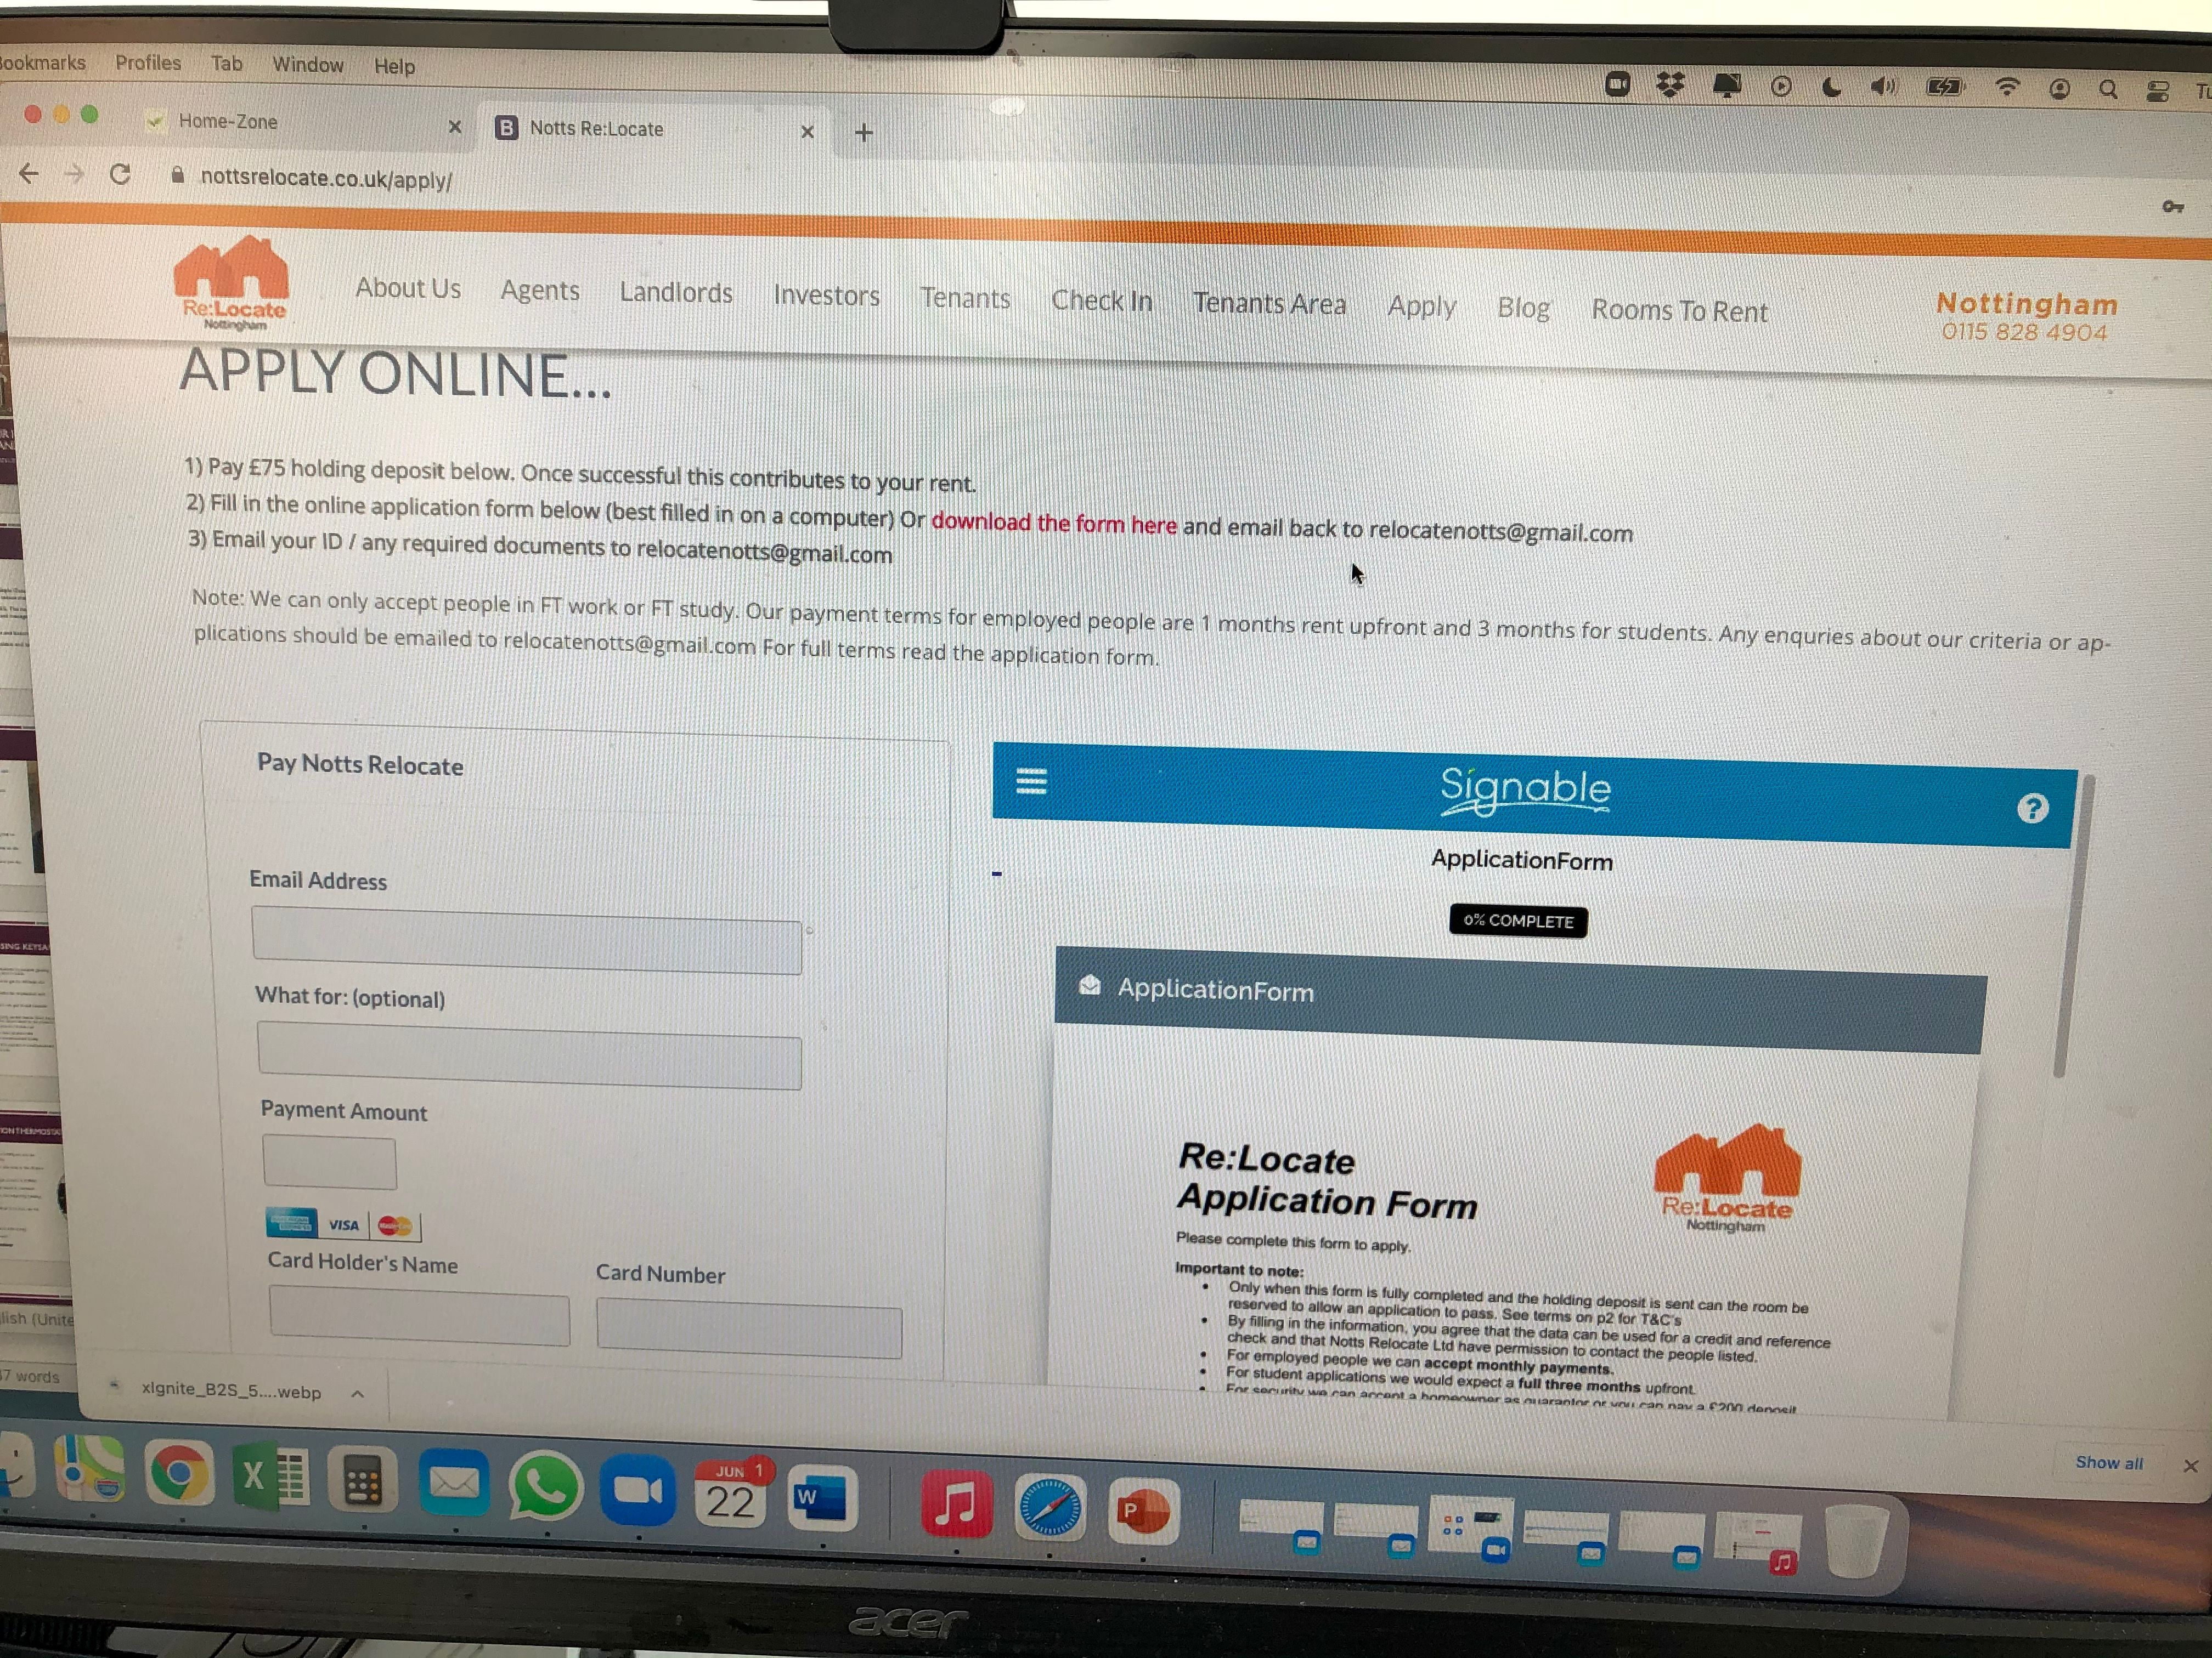

6 – ONLINE APPLICATIONS / Signable
The Problem: Emailing out application forms is time consuming, as is printing tenant paperwork.
Signable overcomes this issues, contracts and applications can all be done online.
It can be used to sign ASTs, client contracts, tenant leaving forms
Signable has a very useful Widget function for integration into websites, so you can handle all applications online.
Our website has a application/payment page for the holding fee linked to Stripe too. See: https://nottsrelocate.co.uk/apply/
https://www.signable.co.uk/
Cost: Just £1 per contract.

Slide 11
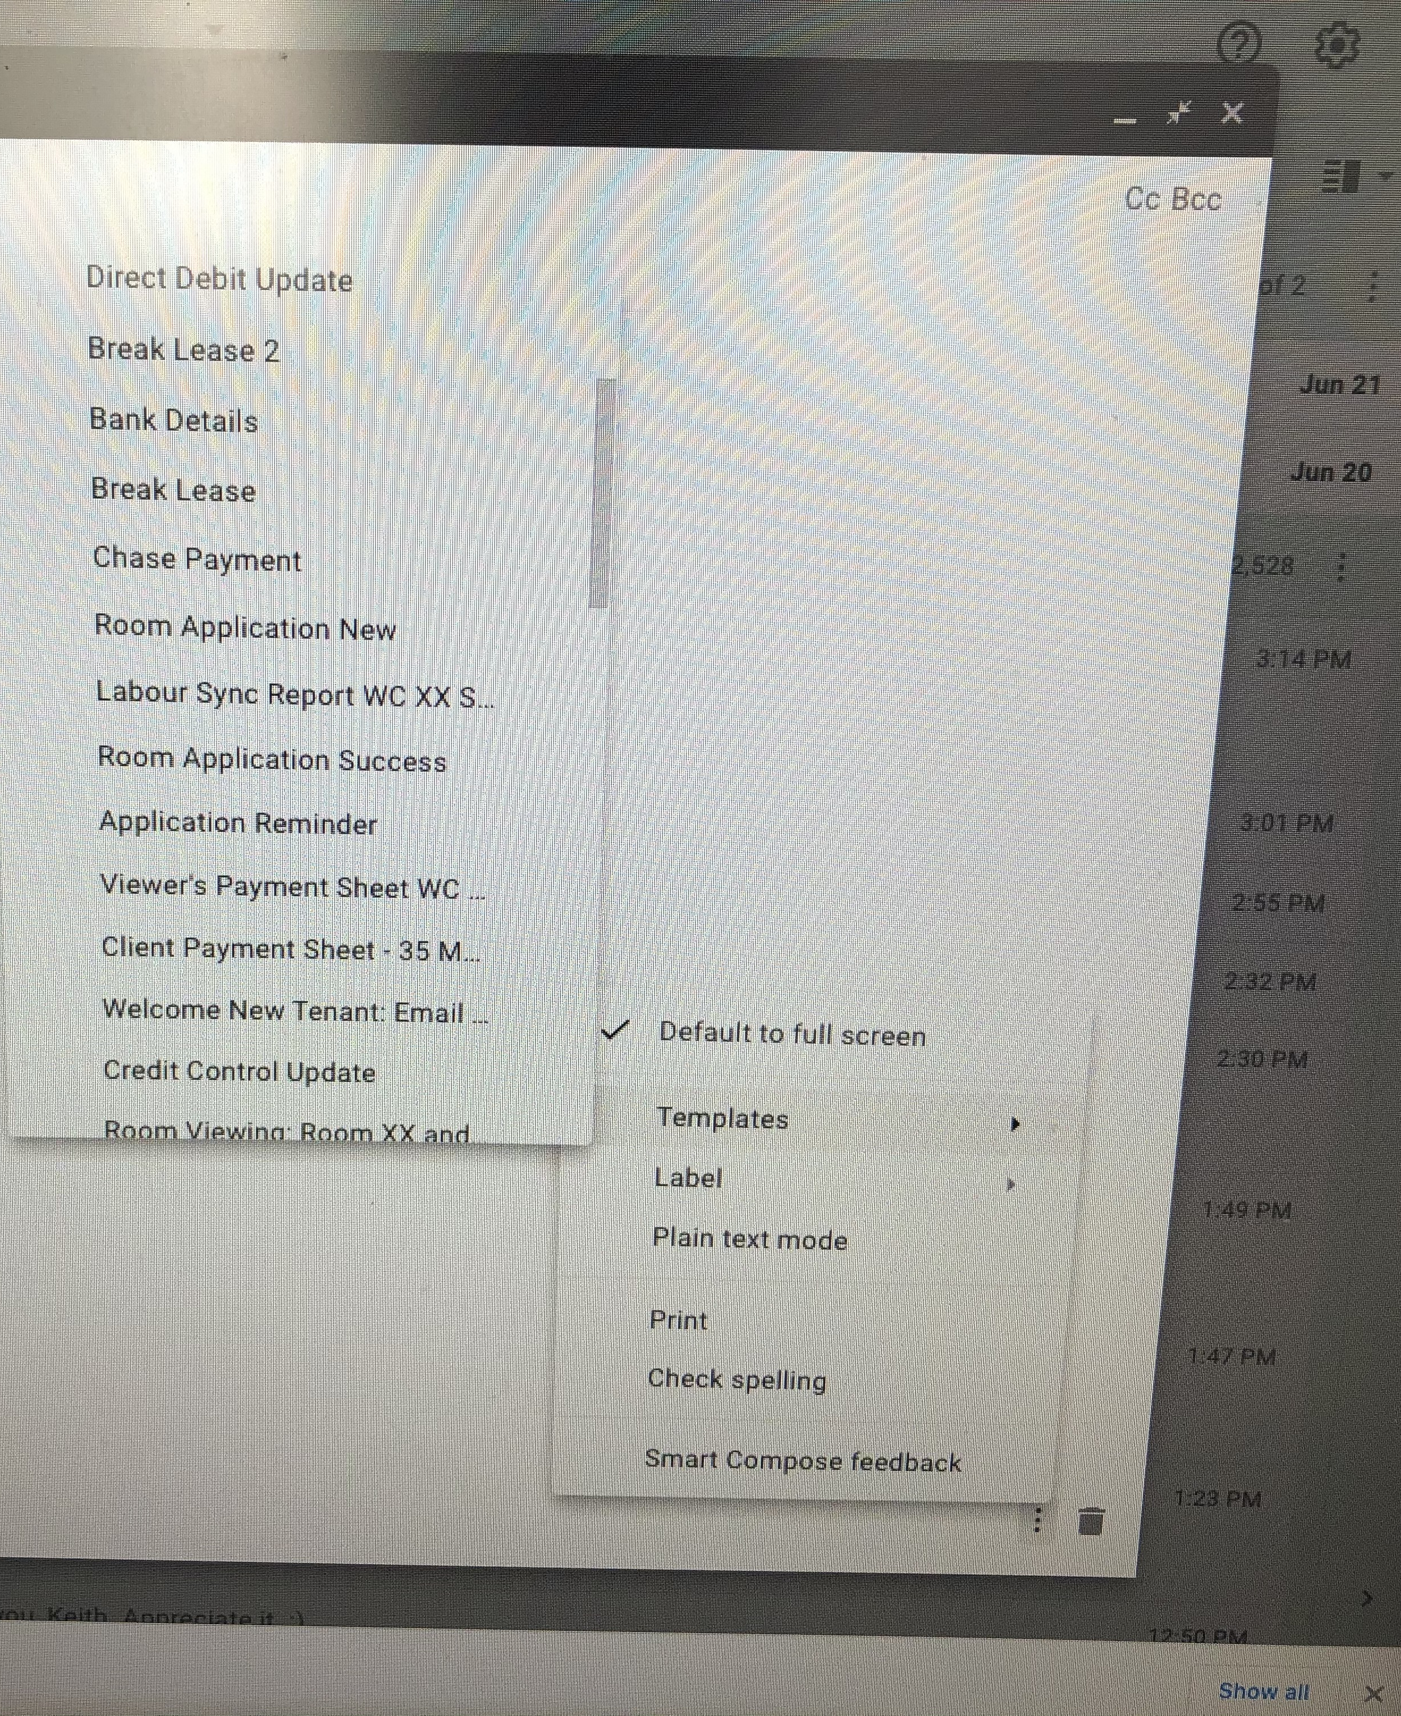
7: Gmail EMAIL Templates
The Problem: One of the biggest waste of time in business we all write the same emails out many times a week. Wouldn’t it be wonderful to be able to drop these standard emails into a new email at the click of a mouse without typing them out?
There is a solution to this. Gmail has a “Templates” function that allows you to save emails, so next time you need it you can just drop it in an email with one click.
With a little bit of upfront work you can save all your regular emails and never have to type out routine emails ever again
Also gives excellent consistency when working with Virtual Assistants.
More info: https://support.google.com/a/users/answer/9308990?hl=en
Cost: Free
Time Saving: 3-4 hrs of time per week.

Slide 12

8 – Labor SYNC
The problem: Using cleaning companies can be expensive and the quality average.
Once you get beyond 40 units you will likely want to employ your own cleaner to deliver cost savings. Directly employed cleaners can go for £10 per hour VS £16-18 per hour at an agency. Indeed is a good website to get cleaners.
Using your own cleaner comes with a drawback though, the management of the cleaner. Cleaners are sometimes unreliable and you need a system to ensure the work is being delivered with minimal management time.
This is where Labor Sync comes in. Labor sync is a GPS attendance app. The cleaner checks in when she arrives at the property and check outs when she leaves. It has a GPS positioning system to we know the location the cleaner checked in and out.
The virtual assistant checks the Labor Sync logs every week to make sure that the cleaner has been at the property on the rota. Along with occasional spot checks and feedback it ensures that the cleaner is accountable, improves performance with less management time required.
It could also be used for an In House Handyman or other staff too.
https://www.laborsync.com/
Cost: $10USD per month
Saving: Cleaning costs will be 40% less.

Slide 13


9 – XERO / Dext
The Problem: HMOs generate a lot of receipts/transactions and bookkeeping can be time consuming
Xero is double entry Accountancy Software that allows for efficient bookkeeping as it imports bank statements. It has several features that are particularly useful for HMOs:
Allows the Virtual Assistant access to bank data without access to the bank account which is ideal for checking off rents received / credit control.
Recurring invoices automatically email tenants when the rent is due.
Rules. Rules can be set up so Xero reads the bank data and automatically codes the bank transaction into the correct account.
Tracking categories. You can code transactions per house to get excellent data and understanding of the true profitability of each property.
Xero also has several add on such as Dext (Formally Receipt Bank) which can automatically read receipts with no human input.
I calculated it was cheaper to use a Virtual Assistant than Dext so I personally prefer sending a simple smartphone photo to my Virtual Assistant who uploads them manually.
www.xero.com https://dext.com/
Cost: Xero £24 per month. Dext: £20 per month

Slide 14

10 – Answer.co.uk
The problem: Inappropriate calls can be made out of hours and there needs to be a way to filter them e.g. someone calls at 10pm wanting to extend a tenancy or enquiring about a room.
The solution is Answer.co.uk is a 24hr call answering service which takes a message and sends a text to your phone with the message. This means you get the key info of why the person needs to speak meaning non urgent calls can be picked up in the morning by staff.
It also can give your business a very professional image as the message is always taken so no calls are missed.
You can also get local numbers to your area.
https://www.answer.co.uk/
Cost: £1 per call. Less with bundles.

Slide 15
11 – Property manager
Property managers are only suitable for landlords with a 50+ rooms. Below 50 rooms it makes sense to do a “Let Only” model with an agent and have yourself act as a supervisor for the Virtual Assistant and pick up more.
To be fully systemized though you will need a property manager in the UK to take overall responsibility and be the boots on the ground.
There are also some tasks it is not realistic to give a Virtual Assistant such as e.g telling a tradesmen off for poor performance, negotiating with problem tenants and obviously carrying out the viewings (if not using an agent)
This does not have to be a full time member of staff on PAYE, if you want to de-risk it and you can pay using the following flexible structure:
a) A monthly ££ retainer per tenant to manage the properties. E.g. £8 per tenant per month.
b) Payment per viewing e.g £10 with a bonus for quick letting.
I would estimate the average pay for my property manager is about £800-£1000 per month.
This structure is ideal for somebody who wants a flexible PT role. E.g. a Working Mum.

Slide 16
Conclusion
Your time is your most valuable resource, HMOs can soon take over your life for an average return.
There are many low cost systems and staffing solutions to save hours and £££’s in HMOs. By implementing some of these inexpensive systems you will become a lot more profitable and most importantly save time.
To save the maximum amount of money & time, using a Virtual Assistant in a low cost country is a great solution.
The systems should run the business with clear workflows & structure. This is where Asana and checklists come in.
Setting up your own team delivers a much better tenant experience and gives you much better leverage over quality, as opposed to an agent where you are just another client.
You can get better quality management than an agent for around 6% of gross rent, 50% of the agents cost standard 12% cost.
As great as the systems are there will always be out of the box situations that require your time, remember there is no such thing as a free yield lunch! If you want a truly hassle free existence HMOs may not be for you.
More Information:
www.mikesmithproperty.co.uk
www.nottsrelocate.co.uk

